Slide 1

Multivariate Analysis
Factor Analysis
Southern Illinois University Edwardsville
Zahra, Sagar, Steven, Yusupha

Slide 2



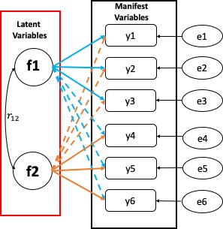
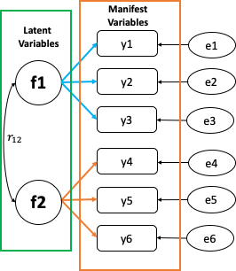
Factor Analysis & It’s Types
Factor Analysis
A method for modeling observed variables, and their covariance structure, in terms of a smaller number of underlying unobservable (latent) “factors.”
Exploratory
Confirmatory
EFA is used to discover the factor structure of a construct and examine its reliability.
It is data driven.
CFA is used to confirm the fit of the hypothesized factor structure to observed (sample) data.
It is theory driven.
4

Slide 3
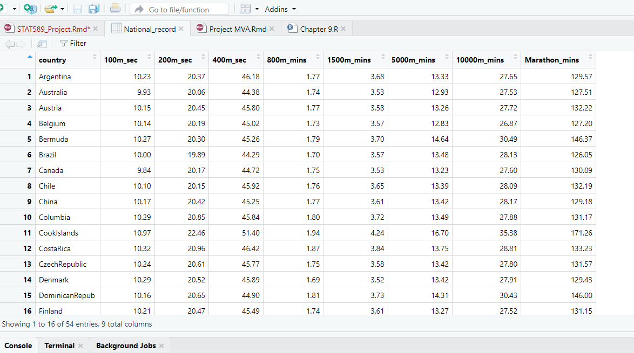
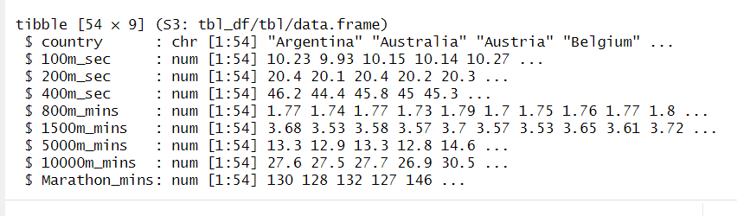
EFA Using R: Data and its Structure
Data file → National track record.xlsx
Data type/structure
All Data columns to be analyzed are Numeric

Slide 4
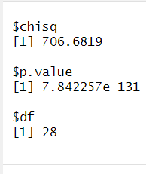
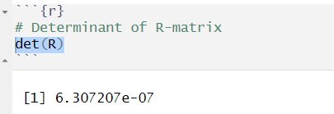
EFA Using R: Initial preparation and analysis
Correlation matrix:
Check the correlations between variables
There are essentially two potential problems:
Correlations that are not high enough
Correlations that are too high.
Bartlett's Test of Sphericity:
Compares an observed correlation matrix to the identity matrix
𝐻₀: R Matrix = Identity Matrix (i.e., There is No Correlation Between Variables)
𝐻₁: R Matrix ≠ Identity Matrix (i.e., There is a Correlation Between Variables)
P-Value < 0.01; so, Bartlett’s test is highly significant (i.e., R-matrix is not an identity matrix);
χ2(253) = 706.6819 , p < .01, and therefore factor analysis is appropriate.
The Determinant of the R-matrix should be greater than 0.00001

Slide 5
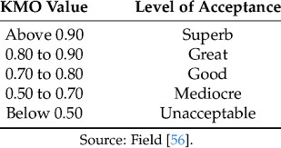
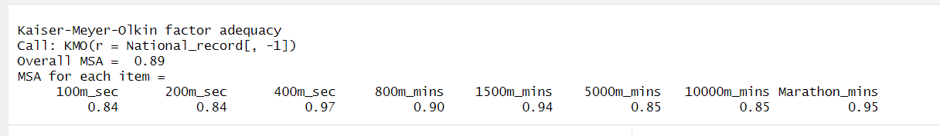
EFA Using R: Initial preparation and analysis…
Sample Size:
KMO Test (Kaiser-Meyer-Olkin (KMO) Measure of Sampling Adequacy):
KMO → The ratio of the squared correlation between variables to the squared partial correlation between variables.
The KMO statistic varies between 0 and 1.
KMO close to 0 indicates diffusion in the pattern of correlations → factor analysis is likely to be inappropriate
KMO close to 1 indicates that patterns of correlations are relatively compact → factor analysis should yield distinct and reliable factors.
Because Overall KMO = 0.89 & values of KMO for all the variables greater than 0.5 so, sample size and the data are
adequate for factor analysis
If any variables with KMO values below .5 then you should consider excluding them from the analysis.

Slide 6
EFA Using R: Factor extraction
Methods of Factor Extraction
PCA Method (Scree plot)
Maximum Likelihood

Slide 7
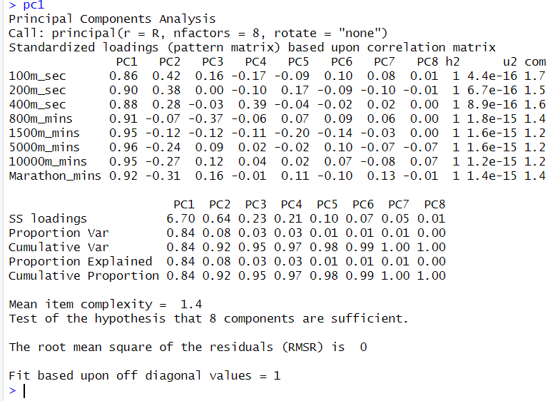
EFA Using R: Factor extraction
Factor Loading Matrix
PCA Method:
By extracting the factors, inspect two columns, communality(h2) and uniqueness(u2)
h2 (communalities) → All equal to 1 (Explained all of the variance in every variable)
Because Factor extracted 8 = number of variables
When we extract fewer factors (or components) we’ll have lower communalities.
u2 (amount of unique variance for each variable) → (1 − communalities) → all of the uniqueness's are 0

Slide 8
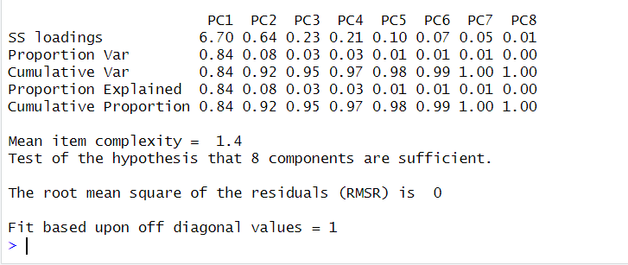
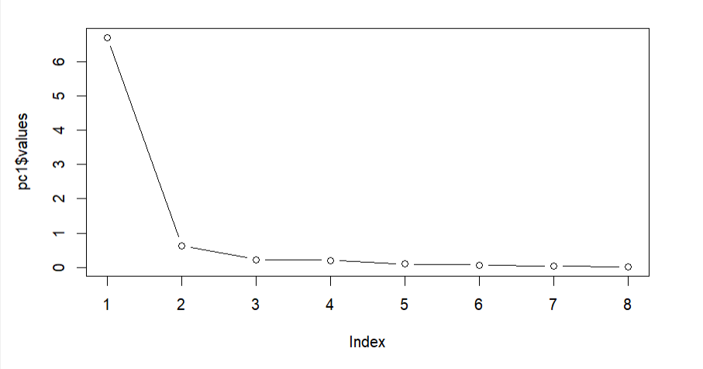
EFA Using R: Factor Extraction
Eigen Values:
The eigenvalues associated with each factor represent the variance explained by that particular linear component.
R calls these SS loadings (sums of squared loadings)
Factor 1 → explains 6.70 units of variance out of a possible 8 (the number of factors) so as a proportion this is 6.70/8 = 0.8375 ≈ 8.4; so, factor 1 explains 84% of the total variance.
Factor Extraction Criteria:
According to Kaiser’s criterion (eigenvalues > 1) → We can pick one components (or factors)
We should also consider the scree plot.
By Scree plot we should take 2 components (or Factors)
The evidence from the scree plot and formula test(later slide) suggests a two-component solution may be the best.

Slide 9
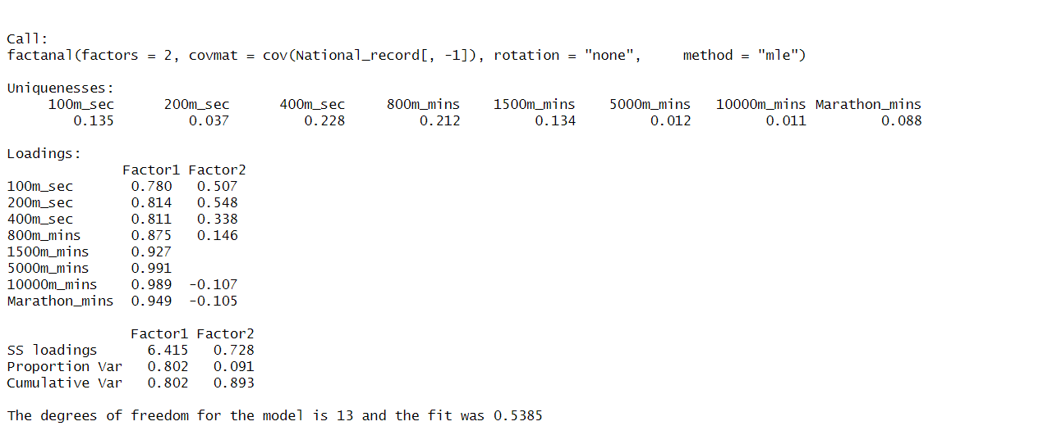
EFA Using R: Factor Extraction
To decide how many factors to extract:
We look at maximum likelihood approach and the scree plot.
Formal test for the number of factors -maximum likelihood approach

Slide 10
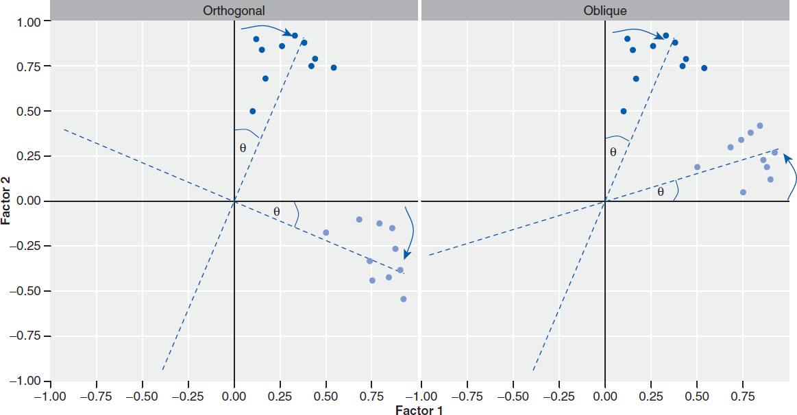
EFA Using R: Factor Rotation
After the factors extraction:
Factor Loading: Calculate to what degree variables load on these factors (i.e., calculate the loading of the variable
on each factor).
Generally, most variables have high loadings on the most important factor and small loadings on all other factors.
Orthogonal rotation ensures that the
Oblique rotation allow the factors to correlate (hence, do not perpendicular).
factors remain independent or
uncorrelated (perpendicular).
Rotation maximizes the loading of each variable on one of the extracted factors while minimizing the loading on all other factors.
13

Slide 11
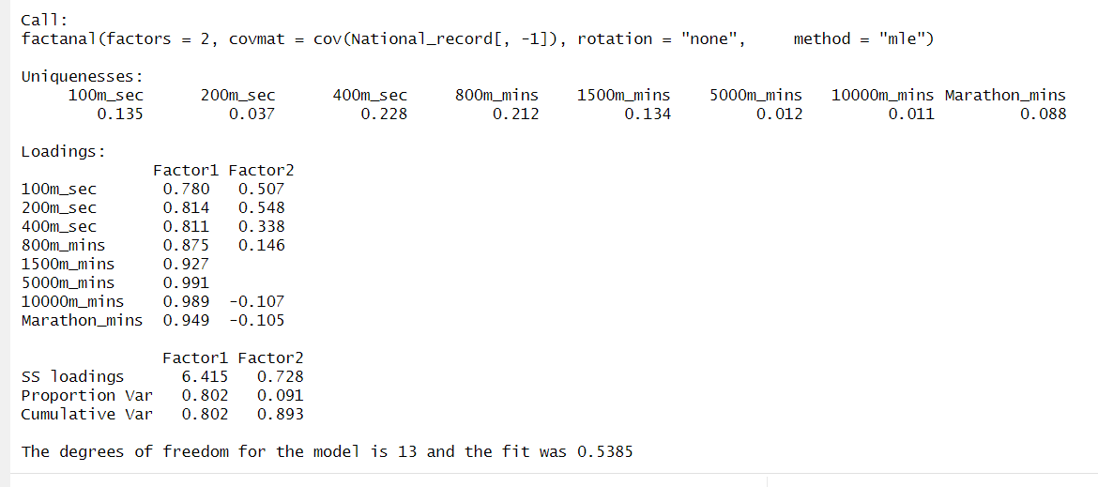
EFA Using R: Factor Rotation → IF None
- The factor loading for last 4 variables seems to contribute for Factor-1
- The first factor is dominated by short length race time, so we can label this factor as Speed
- The factor loading for first 4 variables seems to contribute for Factor-2
- The second factor is dominated by long length race time, so we can label this factor as endurance
- First factor explains 80.2% of Total variance in our dataset
-Second factor explains 9.1% of Total variance in our dataset

Slide 12
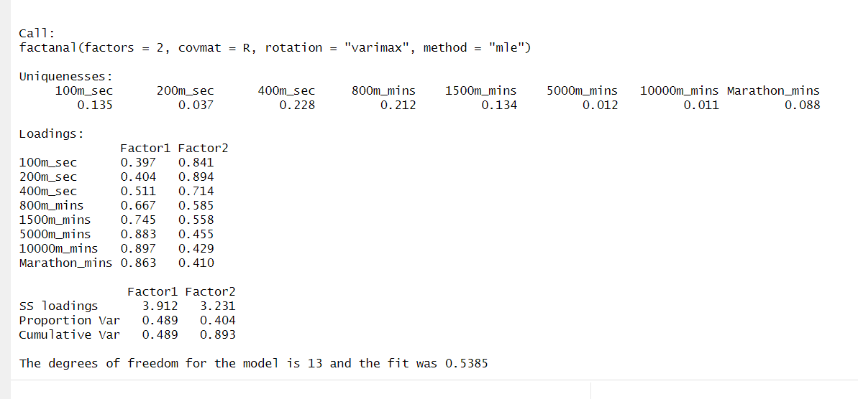
EFA Using R: Factor Rotation → Orthogonal rotation (varimax)
After applying the Orthogonal rotation.
- First factor explains 48.9% of Total variance in our dataset
-Second factor explains 40.4% of Total variance in our dataset

Slide 13
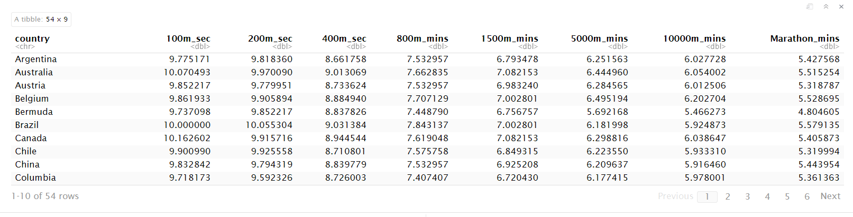
EFA Using R:Data Conversion
16

Slide 14
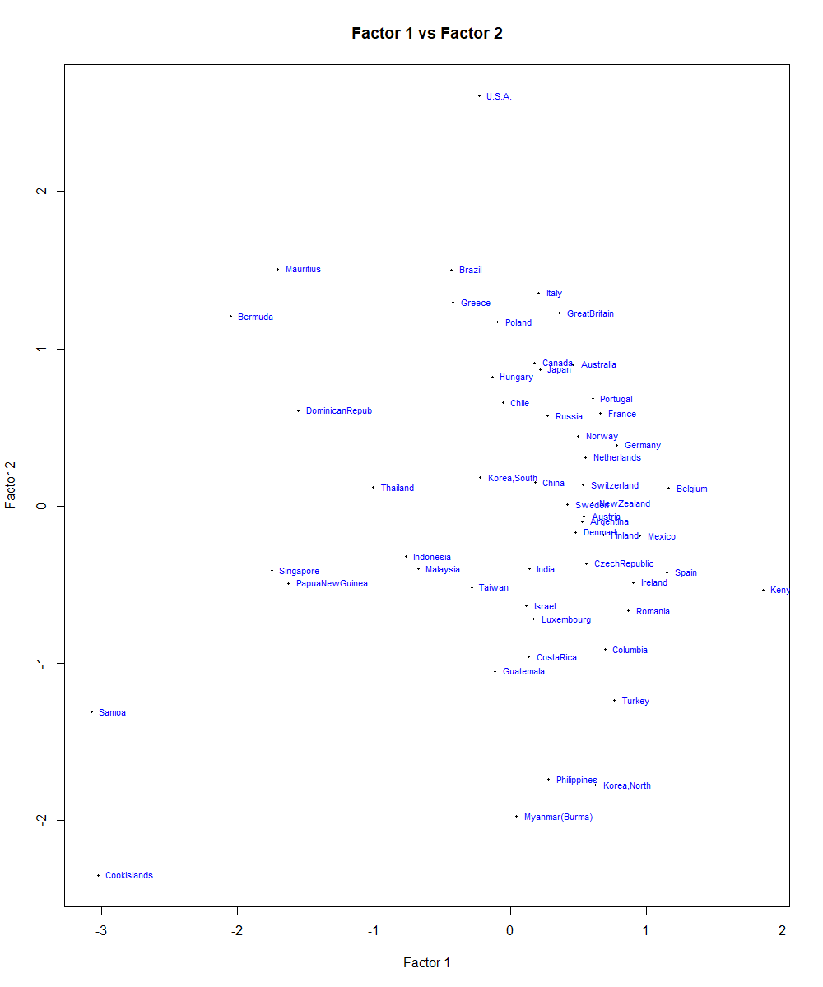
EFA Using R: Factor plot → Factor 1 vs Factor 2
Interpretation:-

Slide 15
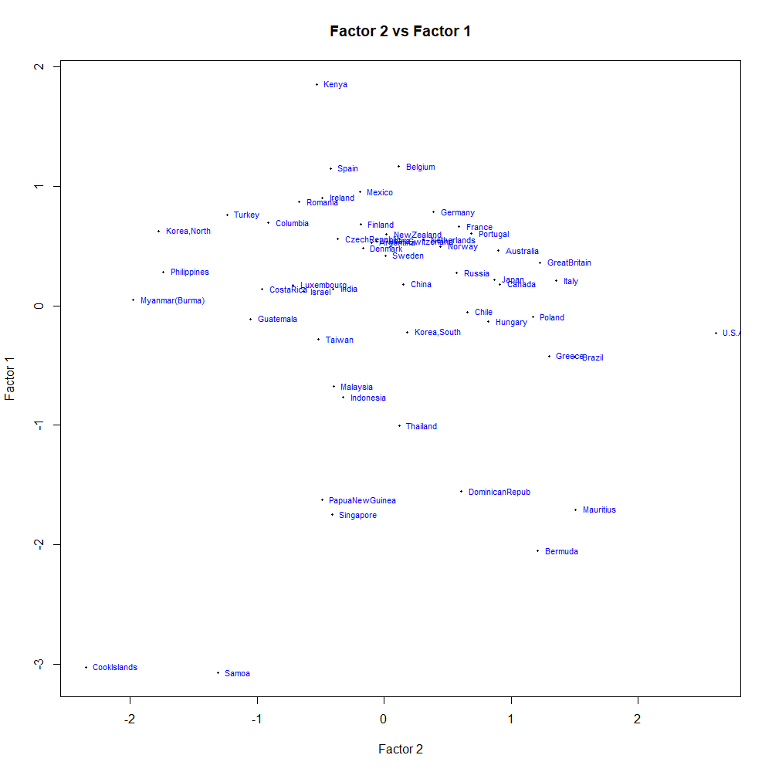
EFA Using R: Factor plot → Factor 1 vs Factor 2
Interpretation:-
18

Slide 16
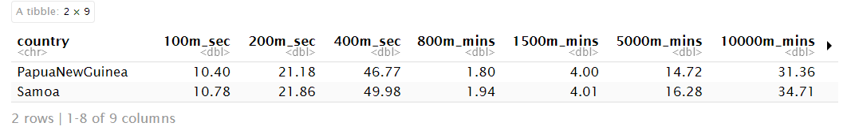
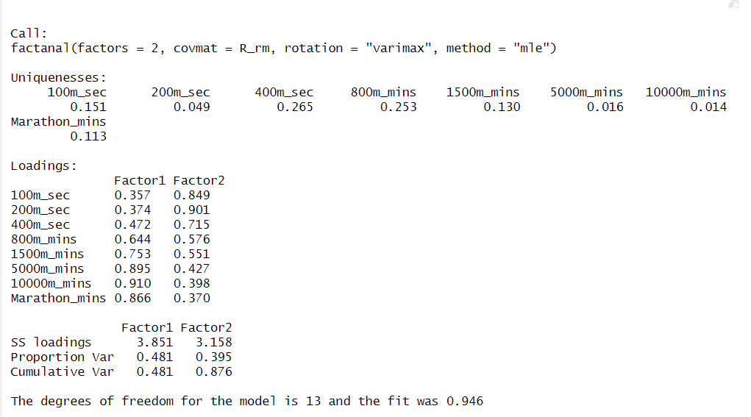
EFA Using R: Outlier detection and Removal
These are the two observation
Which act as outlier
when observer jointly
We are getting the same two
Factor but this time with each variable having good factor loading.
Outlier detection make interpretation and Factor selection nicer.
19

Slide 17
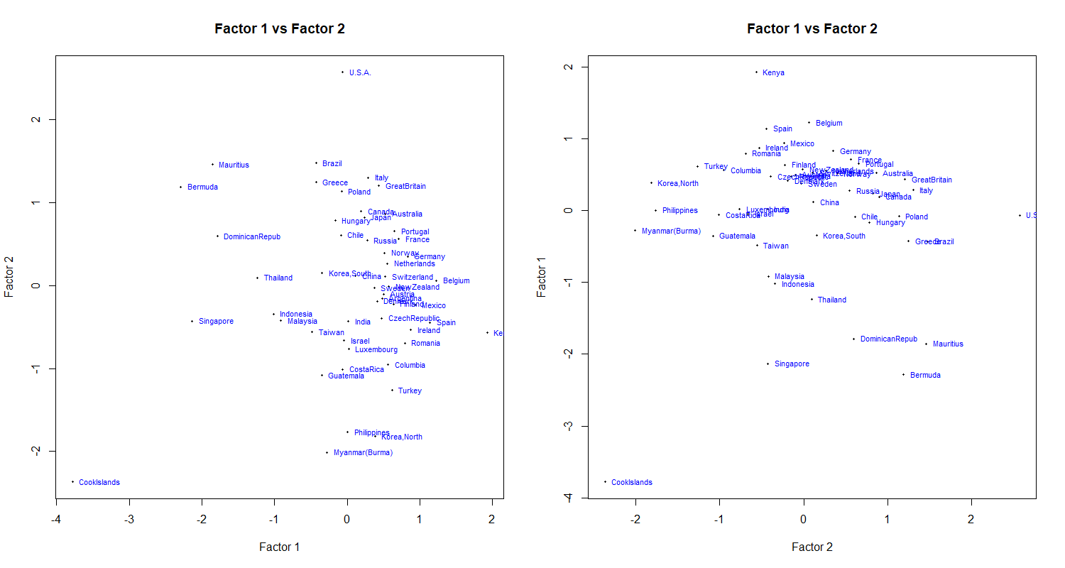
EFA Using R: Factor plot → Factor 1 vs Factor 2 (W/O Outlier)
20

Slide 18





QUESTIONS
21

